Slide 1
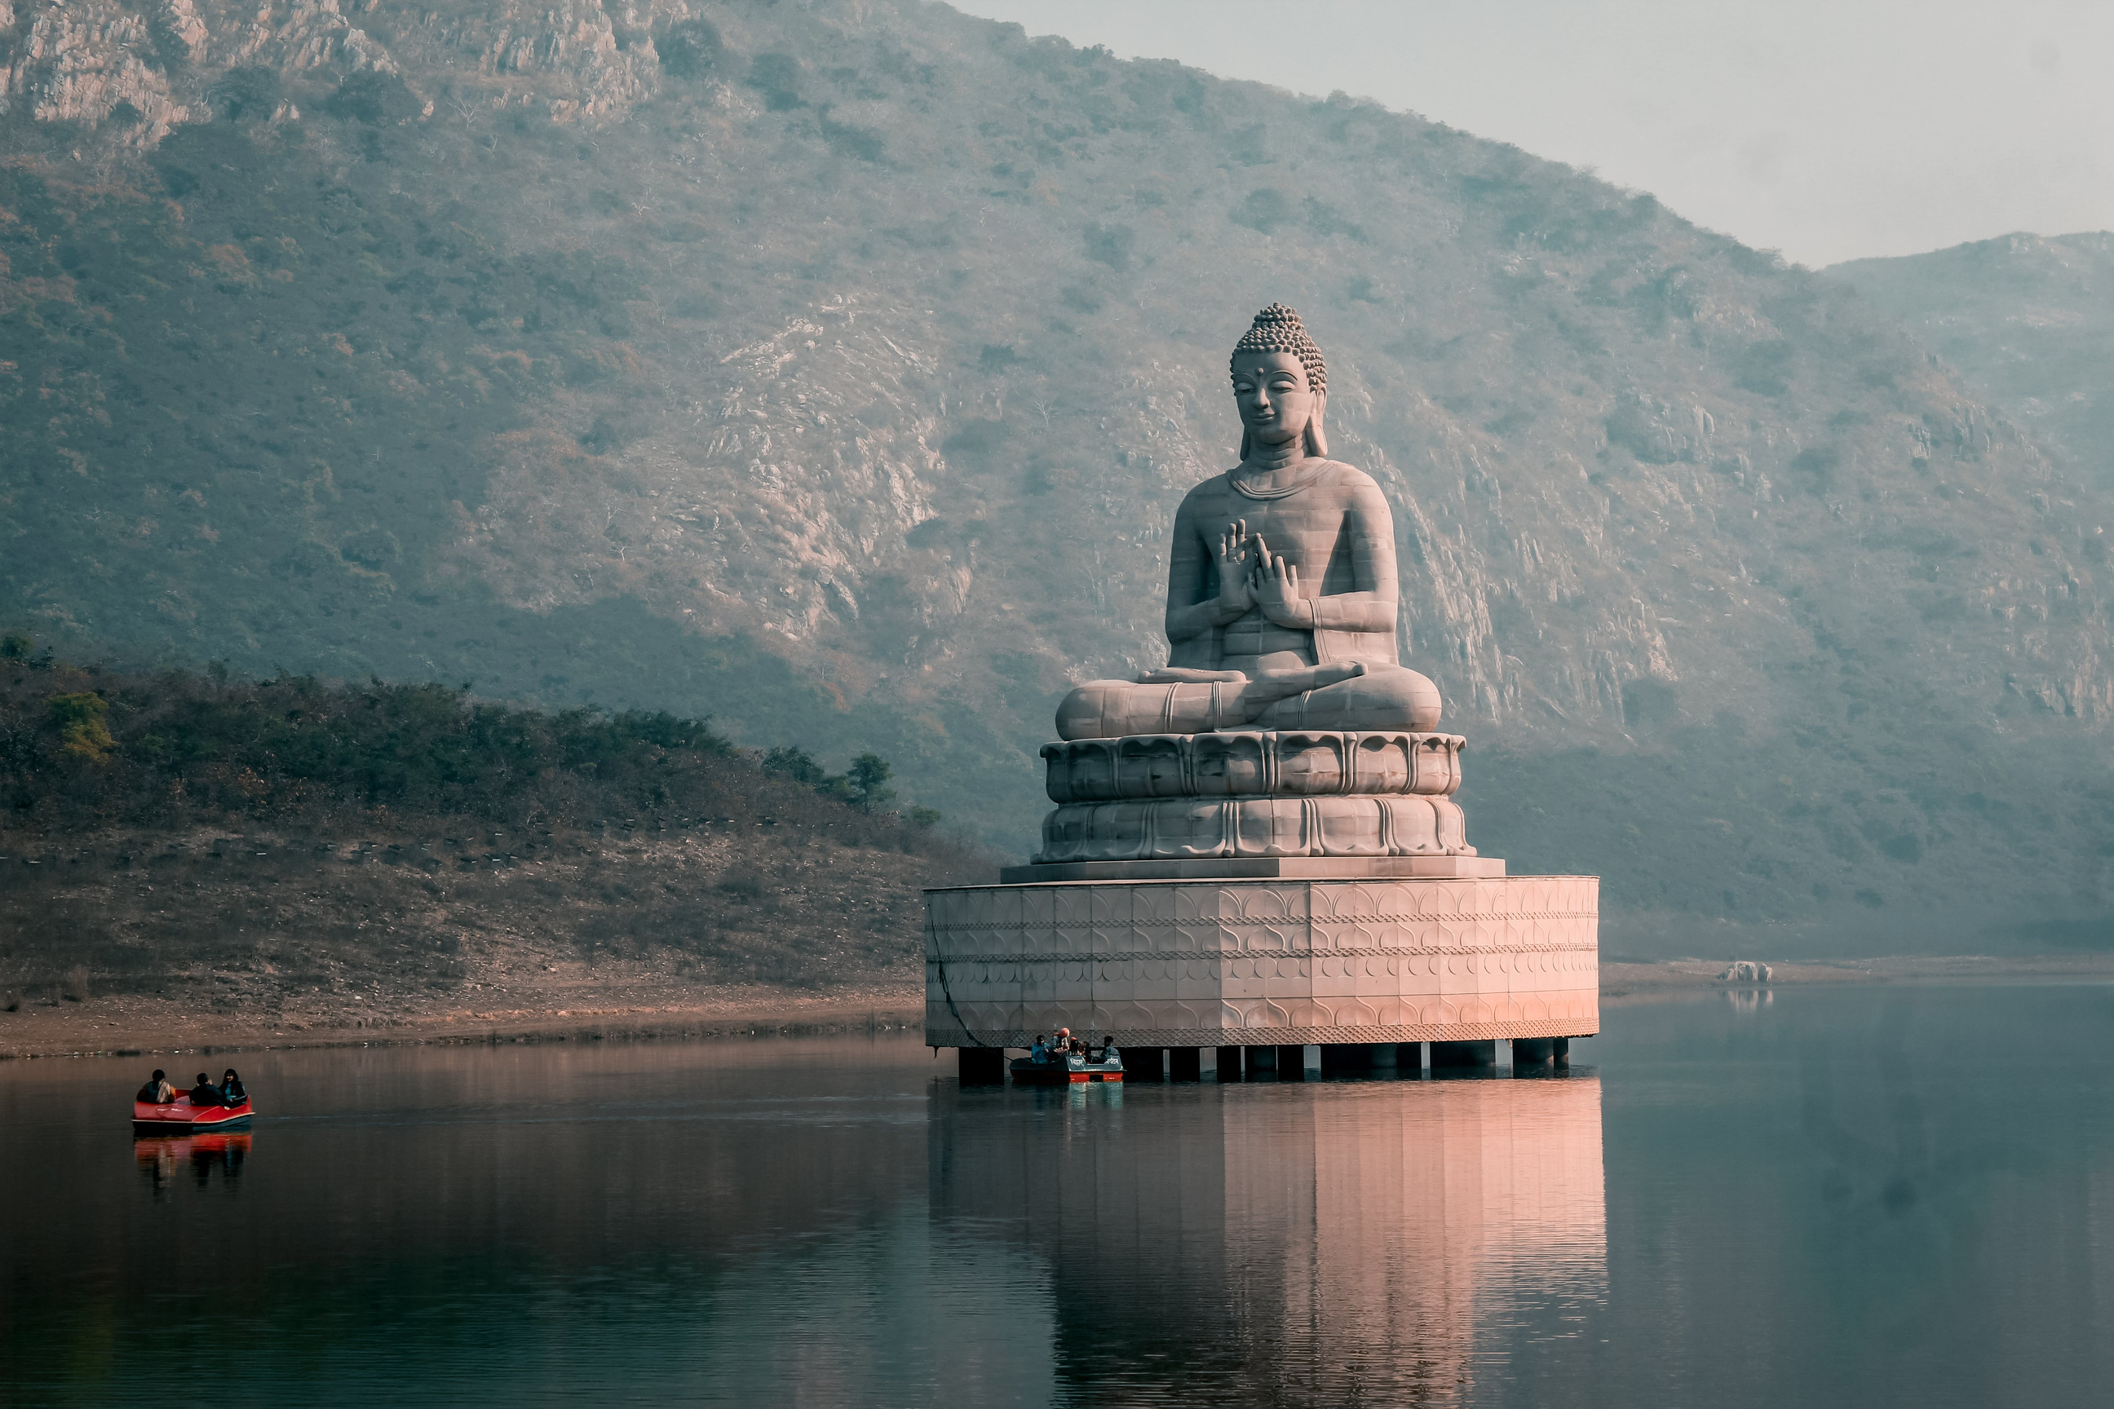
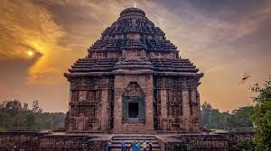
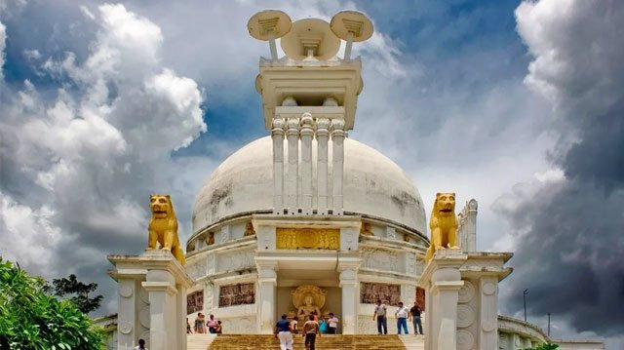
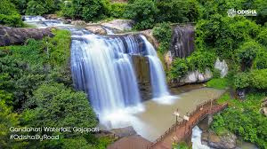
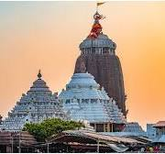
Web Page on
Tourism Places in
ODISHA
Embark on an unforgettable journey to explore Odisha's rich culture, heritage, and natural beauty
GUIDED BY | SUBMITTED BY
Dr Prasant Kumar Dash Asst. Prof., Dept.of CSE CGU , Odisha | GOLDI KUMARI, 2401080041, BCA 1st
01

Slide 2

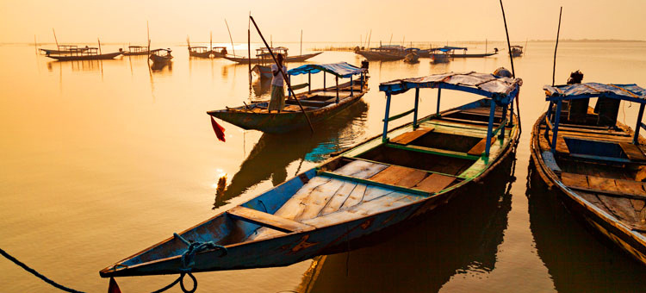
Contents
Introduction
Objective
Language
Flowchart
Key highlights of Website
Conclusion and Future Work
References
02

Slide 3
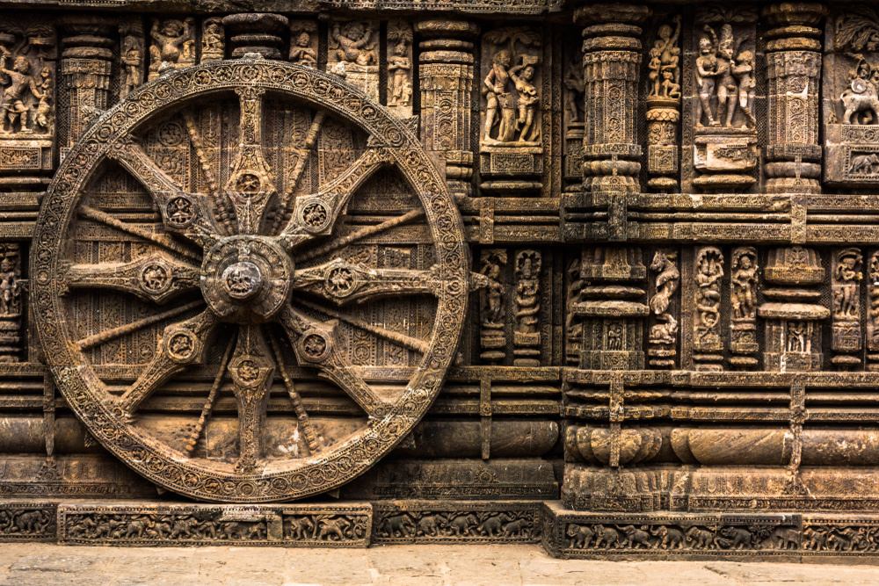
Introduction
Odisha, with its rich cultural history and stunning landscapes, remains an underexplored gem in India's tourism sector. Many potential visitors are unaware of its hidden attractions. The lack of a user-friendly and visually appealing digital platform that provides comprehensive, interactive information on Odisha's tourist spots leads to missed opportunities for travelers.
03

Slide 4
Key challenges
Lack of Interactive and Accessible Platforms: Existing digital resources about Odisha’s tourism are often static and not optimized for mobile or desktop users, leading to a suboptimal user experience.
2.Lack of Consolidated Information: Tourists have difficulty finding a one-stop platform
that integrates detailed descriptions, images, and interactive elements (like maps,
galleries, or event schedules) for each tourist destination.
3.Navigation and User Experience Issues: Most websites lack smooth navigation, are
poorly structured, and do not provide an intuitive way for users to explore multiple
locations quickly.
04

Slide 5
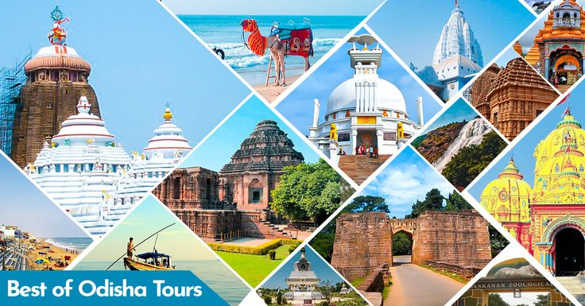
Objectives
Uses HTML for structuring content related to each of Odisha’s tourist spots.
2.Implements CSS for an aesthetically pleasing design, ensuring the site
is responsive and visually appealing across various devices.
3.Integrates JavaScript for enhanced interactivity, such as smooth
scrolling, image sliders, dynamic content loading, and easy navigation.
05

Slide 6
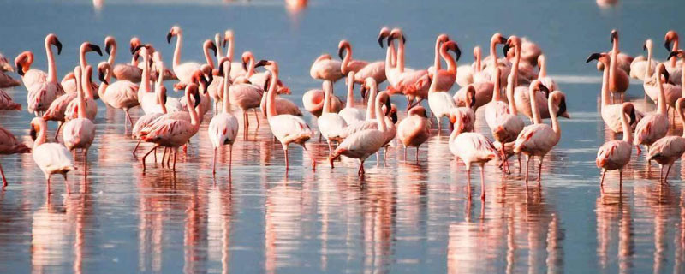
Language
HTML
A
CSS
B
JAVASCRIPT
C
HTML is the backbone of the website, used to structure and organize the content. It provides the basic layout for the webpage, allowing different sections to be marked up correctly. HTML elements are used to define headings, paragraphs, images, links, and other content.
CSS is used for the visual styling and layout of the webpage. It determines how the HTML elements appear on the screen, enhancing the user experience by making the website more attractive, responsive, and functional.
JavaScript is used to add interactivity to the website. It allows the webpage to respond to user actions without reloading the page, providing a dynamic user experience.
WWW.REALLYGREATSITE.COM
06

Slide 7
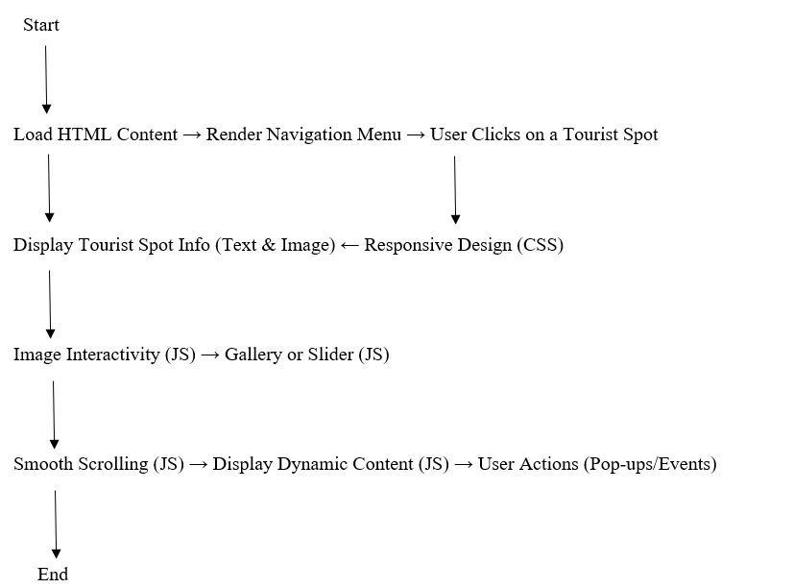
Flowchart
07

Slide 8
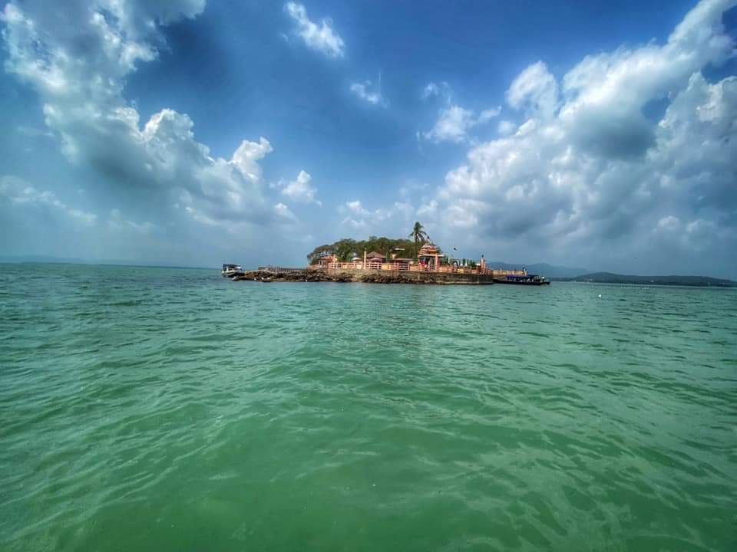
Key Highlights of Website
1. INTERACTIVE WEB DESIGN
2. DETAILED TOURIST SPOT INFORMATION
3. RESPONSIVE DESIGN
4. DYNAMIC CONTENT LOADING
5. SMOOTH SCROLLING AND NAVIGATION
6. IMAGE AND MEDIA INTEGRATION
08

Slide 9
Key Highlights of Website
7.ENHANCED USER INTERACTIVITY
8. CROSS-PLATFORM COMPATIBILITY
9. ATTRACTIVE UI WITH CSS STYLING
10. PROMOTION OF ODISHA TOURISM
11. INTERACTIVE MAPS
12. USER REVIEWS AND RATINGS
09

Slide 10
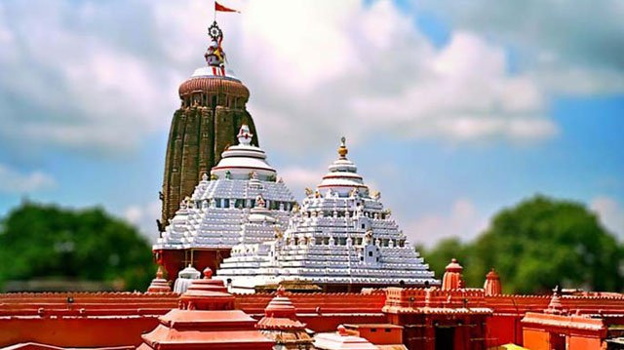
Key Highlights of Website
13. SOCIAL MEDIA INTEGRATION
14. SEO OPTIMIZATION
15. ACCESSIBILITY FEATURES
16. EVENT CALENDAR
17. INTEGRATION WITH BOOKING SERVICES
10

Slide 11
Conclusion
This project successfully showcases how web development can be leveraged to promote tourism and provide visitors with an immersive and interactive experience. It serves as a model for future tourism-related websites, emphasizing the importance of using modern web technologies to create engaging digital experiences.
11

Slide 12
Future works
The current website serves as an effective platform for showcasing Odisha's top tourist destinations. However, there are several avenues for future development to enhance user experience, functionality, and overall impact.
A
12

Slide 13
1. Integration of Dynamic Content (Database/Content Management System)
2. Virtual Tours and 360° Images
3. User Reviews and Ratings
4. Multilingual Support
5. Interactive Maps and Navigation
6. Booking and Reservation System
7. Event Calendar and Notifications
8. Social Media Integration
9. SEO and Analytics Optimization
10. Mobile Application Development
11. Sustainability and Eco-Tourism Focus
04

Slide 14
References
·: https://chatgpt.com/share/67549590-43c4-800e-b2c4-b4bc30eb7d4c
·: https://odishatourism.gov.in
·: https://maps.google.com
·: https://www.w3schools.com
·: https://developer.mozilla.org
A
12

Slide 15
Thank You!
Presented By
SHIVANI KUMARI – 2401080001
GOLDI KUMARI – 2401080041
SADHANA KUMARI – 2401080002
15
01

